Slide 1



Death as a Normal Part of Life
End-of-Life Essentials (EOLE) is a National Palliative Care Project funded by the Australian Government Department of Health and Aged Care and delivered by Flinders University.

Slide 2
Aims and objectives
To develop an understanding of how and when people die in Australia.
After completing this talk, you should be able to:
  Analyse the factors that may influence the trajectories of certain illness groups that can help discussions of prognosis.
  Recognise how your team’s and your own values and beliefs about dying and death influence the care and services provided to people affected by life-limiting illness.
  Begin to identify your own capabilities.
  Identify which End-of-Life Essentials modules to complete.

Slide 3

When does ‘end of life’ begin?
Before we start today, take some time now to think about dying and death.
When should any healthcare professional start to assess patients for signs of approaching end of life?
When the patient is no longer responding to interventions?
When the patient is asking about their prognosis?
When the treatment team refers to palliative care?

Slide 4
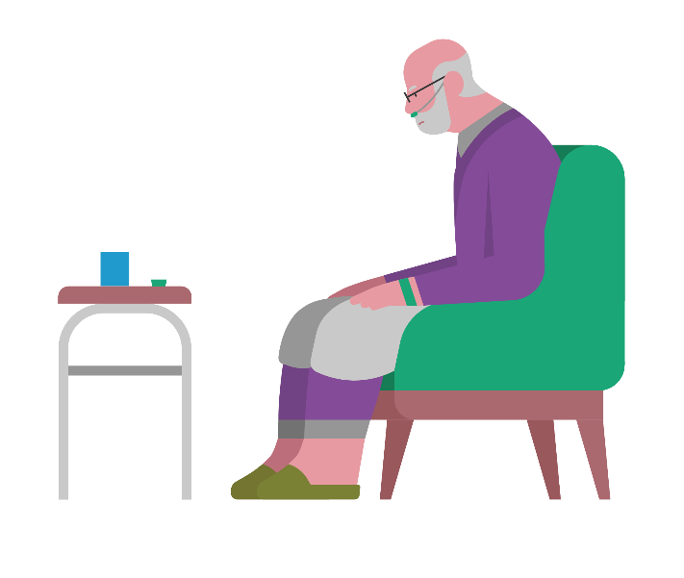
Definitions of Dying and End of Life
It may challenge you to know that the end of life is the period when a patient is living with and impaired by a fatal condition, even if the trajectory is uncertain or unknown. End of life may be 12 months or even years before death¹
Waiting until the very last days, or even hours of life, to identify dying does not allow enough time to provide the best care for someone. Best care should include meaningful conversations and symptom control.
It may challenge you even more to consider providing end-of-life care months or years before death, in parallel with active treatment.

Slide 5
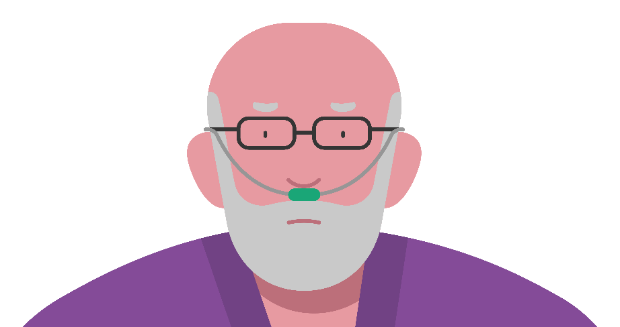
Dying in the 21st Century
Listen to Peter Saul speak about dying in the 21st century (13 minutes): https://www.youtube.com/watch?v=03h0dNZoxr8
One of the tremendous successes of health care in the 21st century is the delay of death or prolongation of life, but health care cannot save life.
Organ failure and frailty are increasingly common causes of death associated with significant disability in the last year of life.
How people die is important for their families who live on.
The ‘Freeway’ to ICU is not necessarily the best place for older patients with advanced progressive illness.²

Slide 6
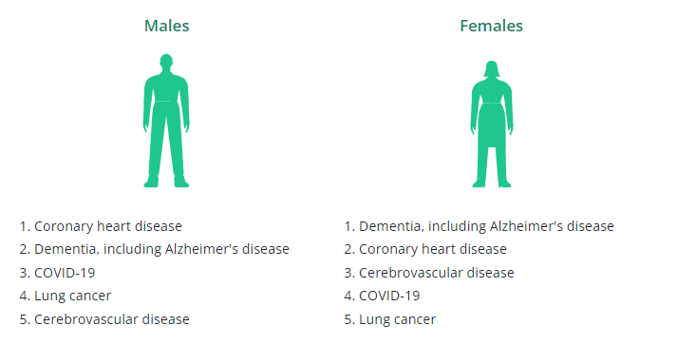
Leading causes of death
The top 5 leading underlying causes of death per sex in Australia³
Notes:
Here we see the top 5 leading causes of death for males and females within Australia during 2022, according to the Australian Bureau of Statistics.

Slide 7
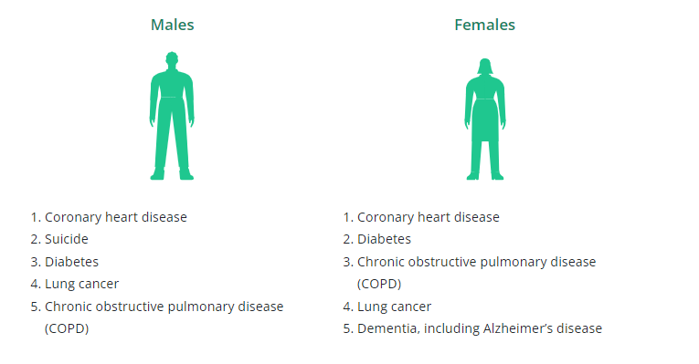
The top 5 leading underlying causes of death per sex for First Nations people³
Notes:
Here we see the top 5 leading causes of death for First Nations males and females within Australia during 2022, according to the Australian Bureau of statistics.

Slide 8
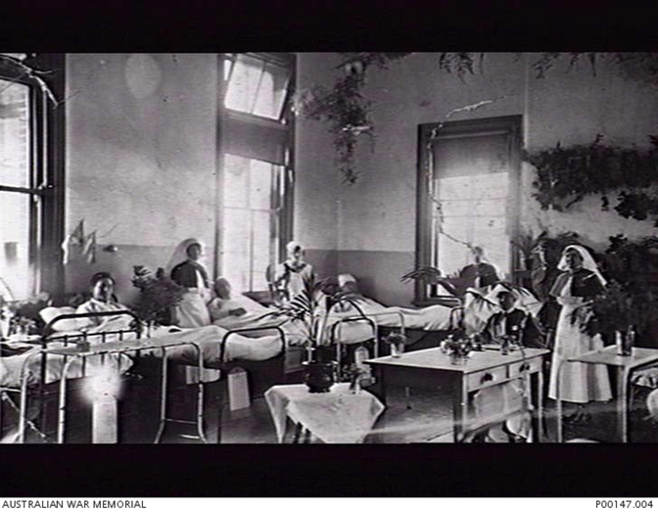
100 years ago – Leading Causes of Death
Respiratory illness
Diphtheria
Gastrointestinal diseases
Influenzas
Life expectancy for a person
born 1920 = 59.2 years (ABS)⁴
Photo -
Australian War Memorial
ADELAIDE, SA, 1920. NO 4 WARD, KESWICK MILITARY HOSPITAL, ADELAIDE, SOUTH AUSTRALIA, IN 1920

Slide 9

Around two thirds of Australians die at 75-95 years of age
Estimated 70% of all deaths are expected
Numbers of Australians who die each year will double in the next 25 years⁵
Think about the population you provide service for in terms of age and illness.

Slide 10

Hospitals
It is estimated that 51% of all deaths in Australia occur in hospitals.⁶

Slide 11
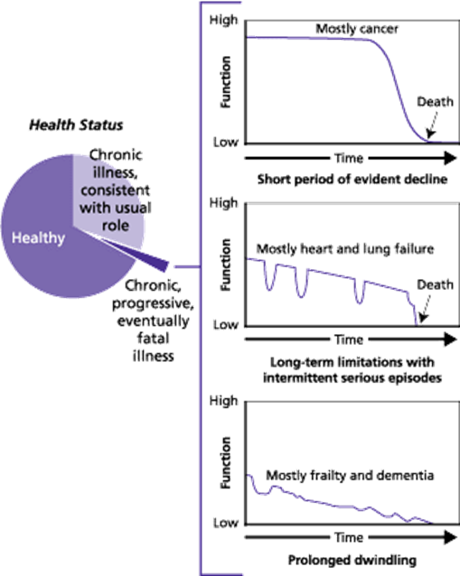
Illness Trajectories
Many of the major illnesses that cause death have a pattern. These patterns or trajectories can assist clinicians to understand the ‘normal’ course, or changing patterns, of illness over a population. Different illnesses typically affect the individual’s function over time.⁷
Knowing about the trajectory of an illness can help to determine the prognosis.

Slide 12

How does your team accept death?
How are the needs of dying patients in your ward or unit met?
Does you team advocate?
Does your team discuss appropriate interventions or treatments for the patient’s stage of illness and suggested pain or symptom control?
Do patients have an opportunity before they die to make known what matters to them?
Notes:
The general indicators are:
performance status
dependency
unplanned hospital admissions
significant weight loss
persistent troublesome symptom
patient request or treatment withdrawal.

Slide 13

Potentially overused interventions⁸
ICU admissions
Non-beneficial medication
Imaging
Life prolonging therapies
Radiotherapy
Chemotherapy

Slide 14
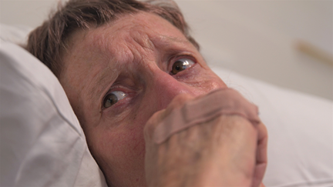
Often underused interventions⁸
Family support
Carefully assessed pain and symptom control
Early conversations about goals of care and what matters to the patient
Emotional, social and spiritual support
Answering questions compassionately

Slide 15

Barriers to quality end-of-life care
What prevents you from having early conversations about patient goals and values?
What psychosocial and spiritual support services are available in your clinical area?
How can you involve these in patient care?
How comfortable are you in prescribing or administering adequate pain relief?

Slide 16
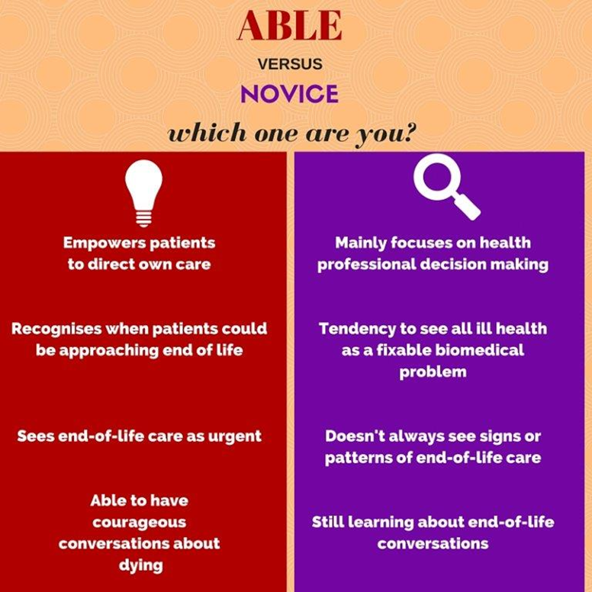
When approaching the care of people who are dying, are you…

Slide 17
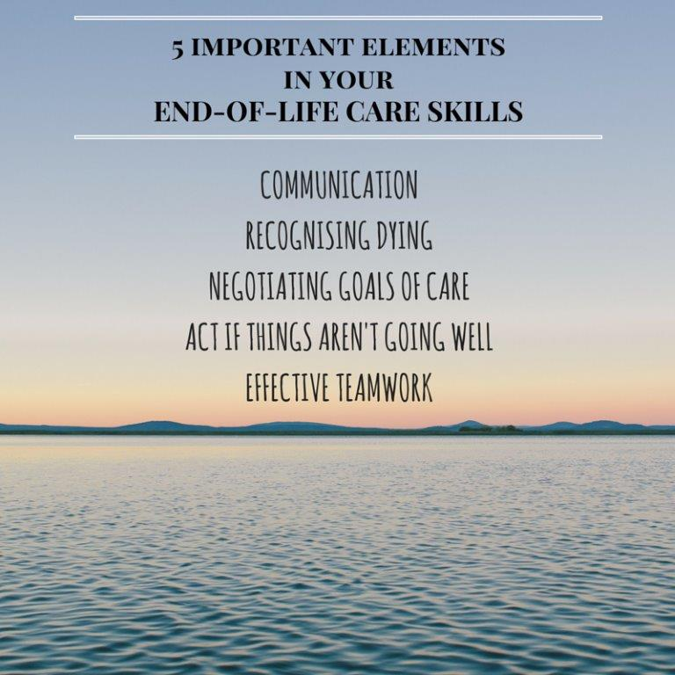

Slide 18
Summary
Dying is a normal part of life - 51% of Australians die in acute hospitals.
End of life may be months or even years or more before death.
Knowing the common patterns or trajectories of illness can help you identify common/normal courses of illness.
Your conversations and skills can avoid a ‘freeway’ to ICU for many patients at the end of life.
Understanding and growing your own capacity for end-of-life care skills can strengthen your practice.
You can adapt and adopt responses to end-of-life conversations and situations.
End-of-Life Essentials advocates proactive approaches to professionals' quality of mental health.

Slide 19




Which modules should I complete first?
Recognising Dying
Imminent Death
Communication and Decision-Making

Slide 20
References
General Medical Council. Treatment and care towards the end of life: good practice in decision making. 2010. Available from: https://www.gmc-uk.org/professional-standards/the-professional-standards/treatment-and-care-towards-the-end-of-life
TEDX Talks. TEDxNewy 2011 - Peter Saul - Dying in 21st century Australia, a new experience for all of us. YouTube; 2011. Available from: https://www.youtube.com/watch?v=03h0dNZoxr8
Australian Bureau of Statistics. Causes of death Australia. 2022. Available from: www.abs.gov.au/statistics/health/causes-death/causes-death-australia/latest-release
Australian Bureau of Statistics. Life Expectancy Trends – Australia. 2011. Available from: https://www.abs.gov.au/AUSSTATS/abs@.nsf/Lookup/4102.0Main+Features10Mar+2011
Swerissen H, Duckett S. Dying well (957kb pdf). Grattan Institute. 2014.
Australian Bureau of Statistics. Classifying Place of Death in Australian Mortality Statistics. 2021. Available from: https://www.abs.gov.au/statistics/research/classifying-place-death-australian-mortality-statistics
Lynn J, Adamson DM. Living well at the end of life. Adapting health care to serious chronic illness in old age. Rand Corporation. 2003. Available from: https://www.rand.org/pubs/white_papers/WP137.html
Bernacki R, Block S. Communication About Serious Illness Care Goals. JAMA Intern Med. 2014;174(12):1994-2003.

