Slide 1



How to support yourself and other staff after a patient has died
End-of-Life Essentials (EOLE) is a National Palliative Care Project funded by the Australian Government Department of Health and Aged Care and delivered by Flinders University.

Slide 2
Aims and objectives
To develop an understanding of how to support yourself and others.
After completing this talk, you should be able to:
Analyse the factors that may influence your own wellbeing
Begin to identify your own capabilities in effective self-care
Identify which End-of-Life Essentials module to complete next.

Slide 3

Think about you
When it comes to self-care, consider what works for you.
Ask yourself – “What does self-care look like?”
What is your work/life balance?
Do you actively practice self-care?
What do you do to relax, unwind, or switch off from work?

Slide 4

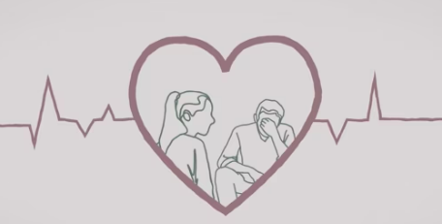
Responding to grief and bereavement
How people respond to grief and bereavement is different for everyone. Finding positive strategies to manage your own responses to grief when caring for patients at the end of life, can lead to better understanding patient experiences, and better support for bereaved families.
CLICK THIS LINK
To watch the film ‘Responding to grief and bereavement’ (3 min 30 sec)

Slide 5

Debriefing
Talk and debrief with your supervisor, counsellor, friend, or trusted colleague.
Are you aware of what is available to you in order to debrief?
Are there post-shift debriefs?
Do you only debrief following a critical incident?
Do you debrief at all as a team?
Find your own source of support within or external to your organisation.
Employee Assistance, your manager/supervisor, a colleague, a friend, reflective clinical supervision.

Slide 6
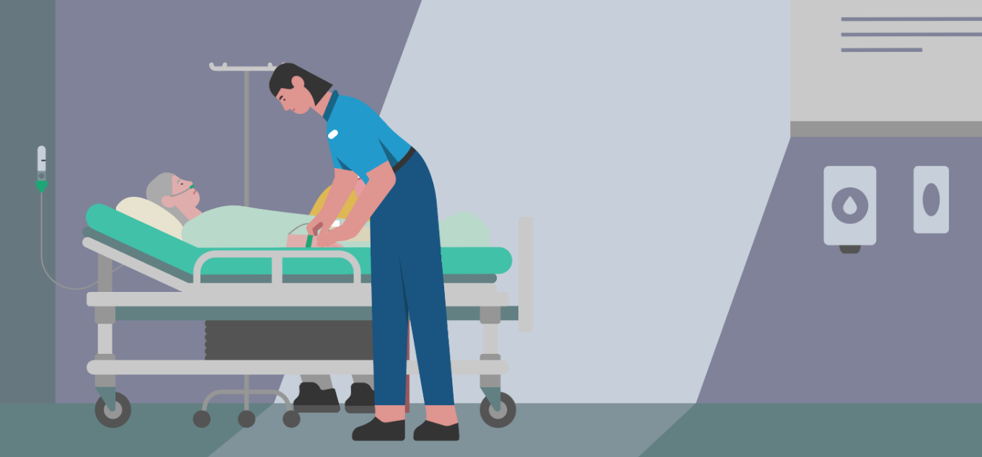
Acknowledge each death
Do you have rituals in place to acknowledge each death?
For example:
‘The Pause’ in ICU and ED
Reading out the name(s) of those who have died at handover
Taking a minute yourself to say goodbye to someone you have cared for - perhaps when certifying a death or laying out the body.

Slide 7
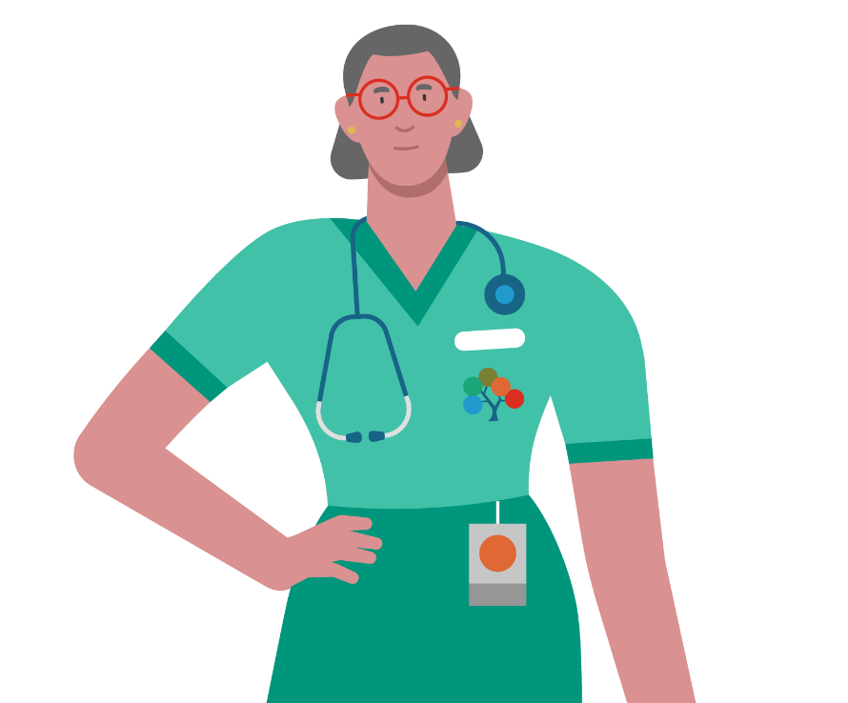
Explore your own reactions and beliefs
Take time to explore your own reactions and beliefs around end of life, and what matters to you.
Consider whether your views are impacted by:^{1,2}
Spirituality
Death anxiety
Culture
What you consider a ‘good death’ to look like
Religion/ atheism

Slide 8
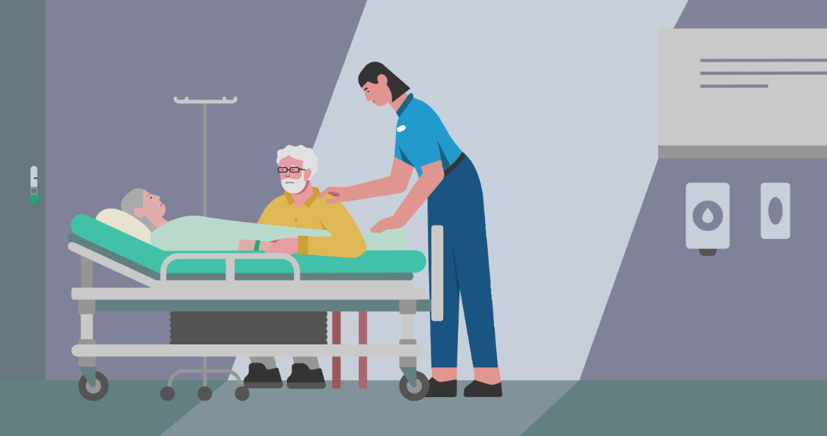
If you were not there when the patient died…
If you were not on the ward at the time of a patient’s death, try and get a sense of their last hours.
Consider asking colleagues what it was like for them.
Critical incident analysis/audit may shed light on a situation that could have been handled differently.
Is it usual practice to follow up families/spouses/significant others following a death?

Slide 9
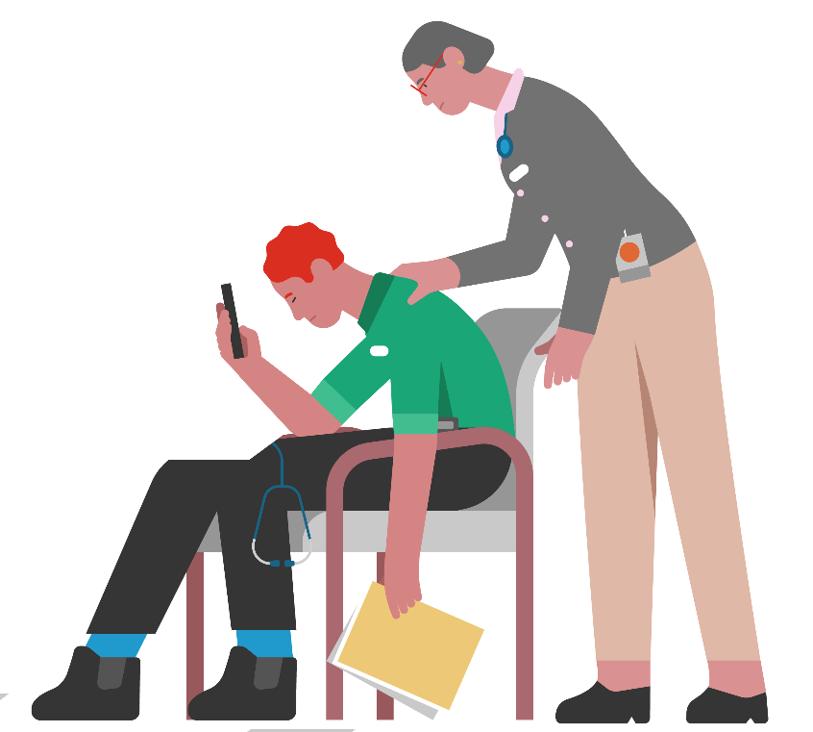
Negative outcomes of unrecognised/ unacknowledged grief
It may be useful to understand that not recognising work-related grief can have negative consequences for workers, both personally and professionally, including:
Emotional distancing, numbing or ‘shutting down’.
Disenfranchised grief - no acknowledgement that grief is appropriate or felt at work – this can lead to grief being seen to be a personal failing in the individual worker.
Compassion fatigue – repeated exposure to unrelenting suffering and sorrow through witnessing deaths in the workplace.³

Slide 10

Understanding self-care
CLICK THIS LINK
To watch the film ‘Self-Care Matters - Understanding self-care’ (3 min 39 sec) from Palliative Care Australia.
CLICK THIS LINK
To watch the film ‘Diana’s story’ (4 min) from Beyond Blue.

Slide 11
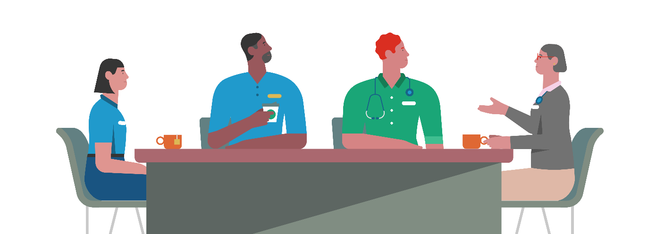
Supporting the team
Who do you consider to be a part of your team?
Does this include staff outside of the immediate healthcare team (e.g., housekeeping/domestic staff, pastoral care/chaplains)?
Do you know where you can access support in your organisation?
Are there resources locally that you can tell colleagues about?

Slide 12
Summary
Supporting yourself and other staff after a patient has died can be strengthening to your team and yourself.
Having insight into your own experiences of and beliefs about grief can enhance and deepen your bereavement care at work.
Acknowledging the deaths of patients and your own compassion can strengthen your clinical practice.
End-of-Life Essentials advocates proactive approaches to professionals' quality of mental health.

Slide 13


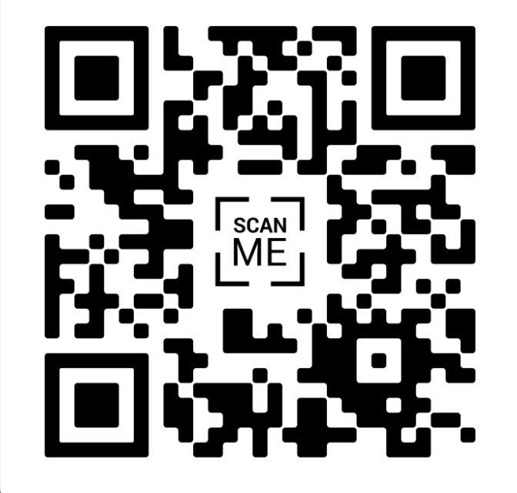

Which modules should I complete next?
Communication and Decision-Making
States of Mind at the End of Life
Voluntary Assisted Dying in Acute Hospitals

Slide 14
References
MacLeod et al., 2019. Death Anxiety Among New Zealanders: The Predictive Roles of Religion, Spirituality, and Family Connection Omega: Journal of Death and Dying, 80(1), p.3-19.
Rushton C., Edvardsson, D. 2021. A genealogy of what nurses know about ‘the good death’: A socio‐materialist perspective. Nursing philosophy, 22 (4), p.e12365-n/a
Cocker F, Joss N. Compassion Fatigue among Healthcare, Emergency and Community Service Workers: A Systematic Review. Int J Environ Res Public Health. 2016;13(6).

